Slide 1
Attend-In
Steven Stewart - Project Manager
Nicole Grizzle - Scrum Master
Eric Kelly - Programmer 1
Cameron Sumlin-Eskridge - Programmer 2
Hard Thakkar - QA

Slide 2

Attend-In
Attend-In is an Android app that takes attendance by verifying that students are in class within a timed window.
Target Audience: Professors and Students
Attend-In will:
Reduce Cheating
Reduce Time Spent on Attendance

Slide 3


Technology
Programming Language: Java
Platform: Android
IDE: Android Studio
API for GPS Coordinates: IPStack

Slide 4
Completed Stories
Sending API requests after logging in
Creating an Icon
Access Team Prim’s API
Create Class Selection Page for Students
Create a Page to Create New Classes for Professors
Create a Page to View Class List for Professors
Create Test Data for Student Classes
Create UML Diagram for Facade Pattern

Slide 5
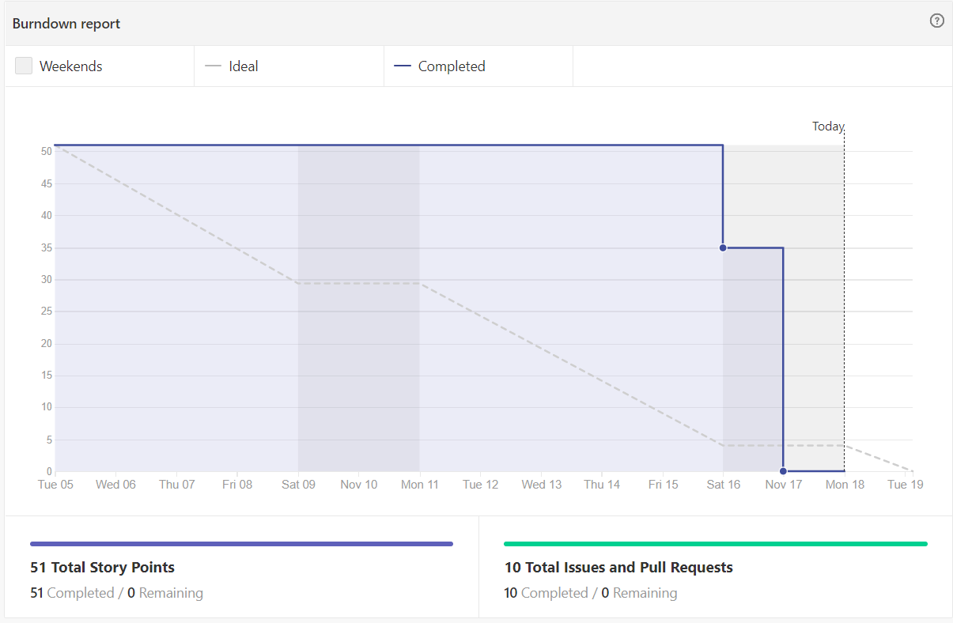
Burndown Chart
Notes:
This is not the ideal burndown chart, but here’s why it looks like this. A lot of the Sprint was just planning--many of the interface elements were already created in previous sprints, so we needed to figure out how we were going to show that data. There was a lot of back and forth between teams, figuring out if and when we can connect databases as well as connecting

Slide 6
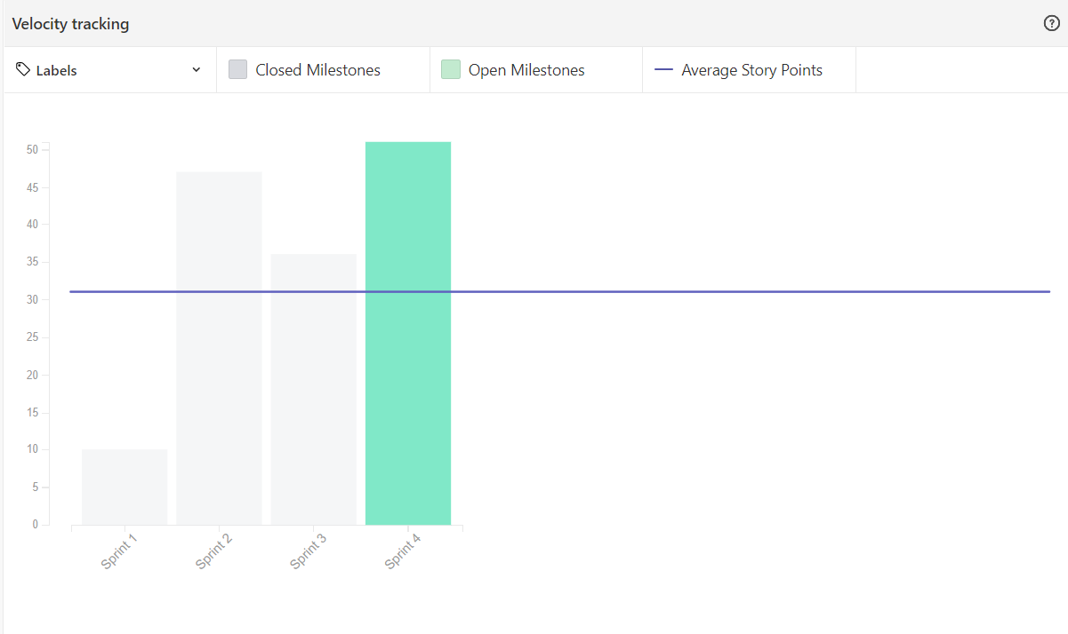
Velocity Chart

Slide 7
Design Pattern: Facade
Simplifies the client-facing interface and keeps core functionality in separate classes for ease of maintenance.
Student side: Client-side view that pulls functionality from StudentLoginActivity and sendApiRequest classes.
Professor Side: Client-side view that pulls functionality from ProfessorLoginActivity and TeacherTimerActivity classes.

Slide 8
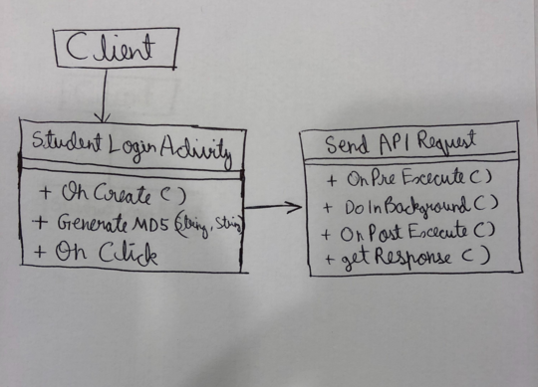
UML Diagram for the Student

Slide 9
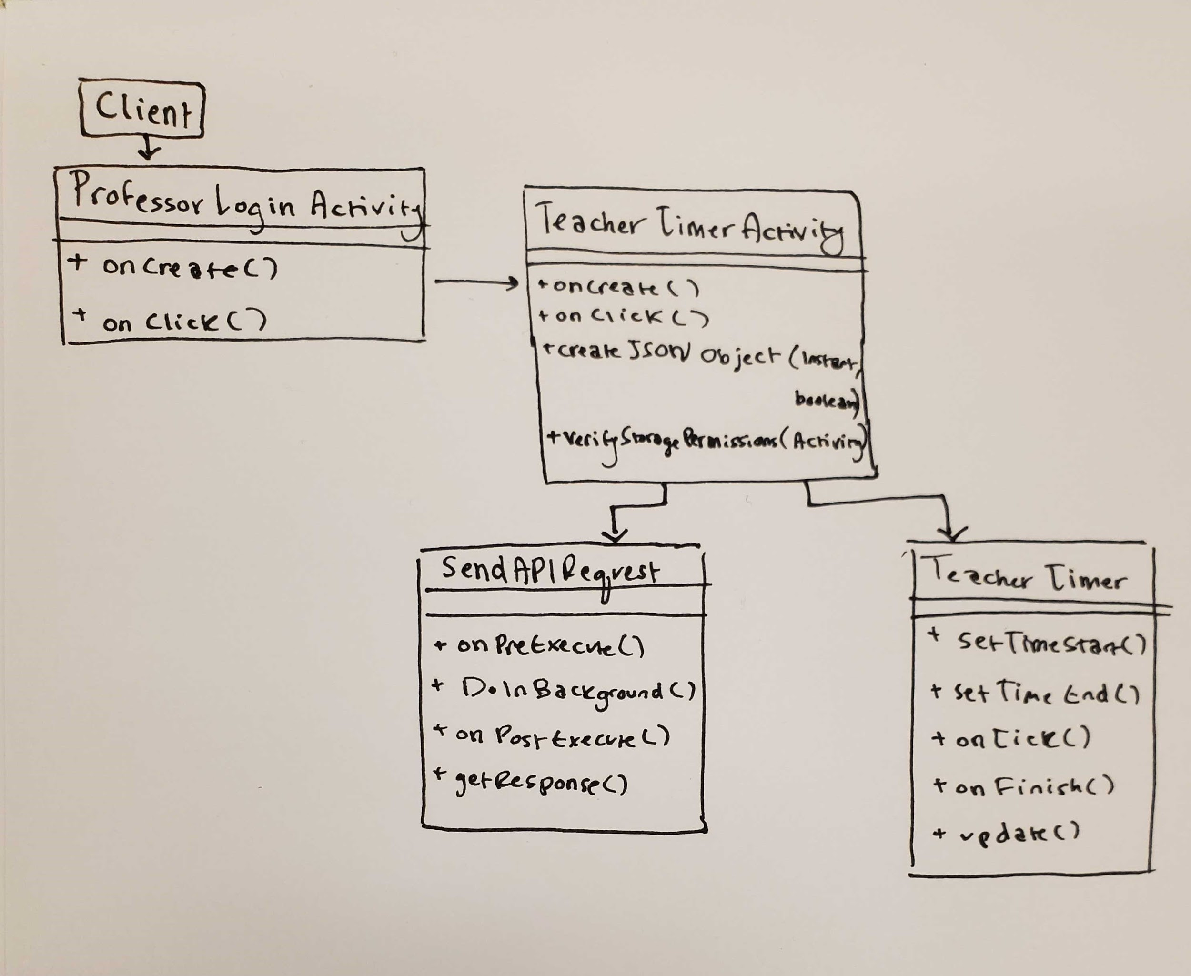
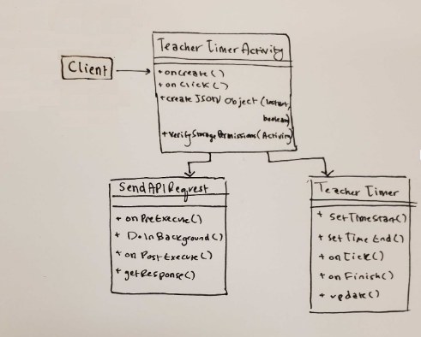
UML Diagram for the Professor

Slide 10
Questions?

